Slide 1
Assignment 1
Asim 2
Tim Goll 2554050
Matthias Jost 2551592

Slide 2
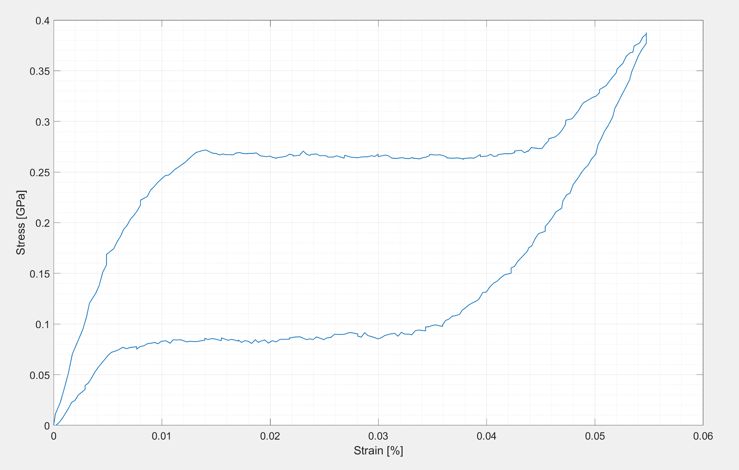
Exercise 1

Slide 3
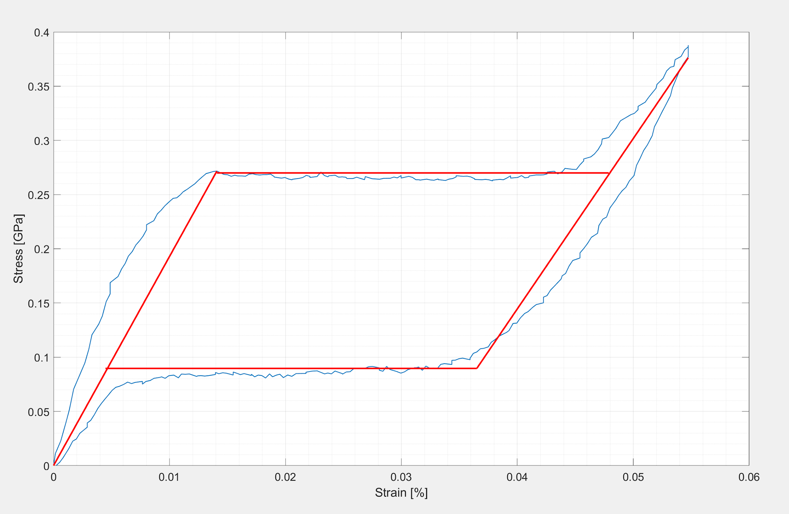
Exercise 2

Slide 4
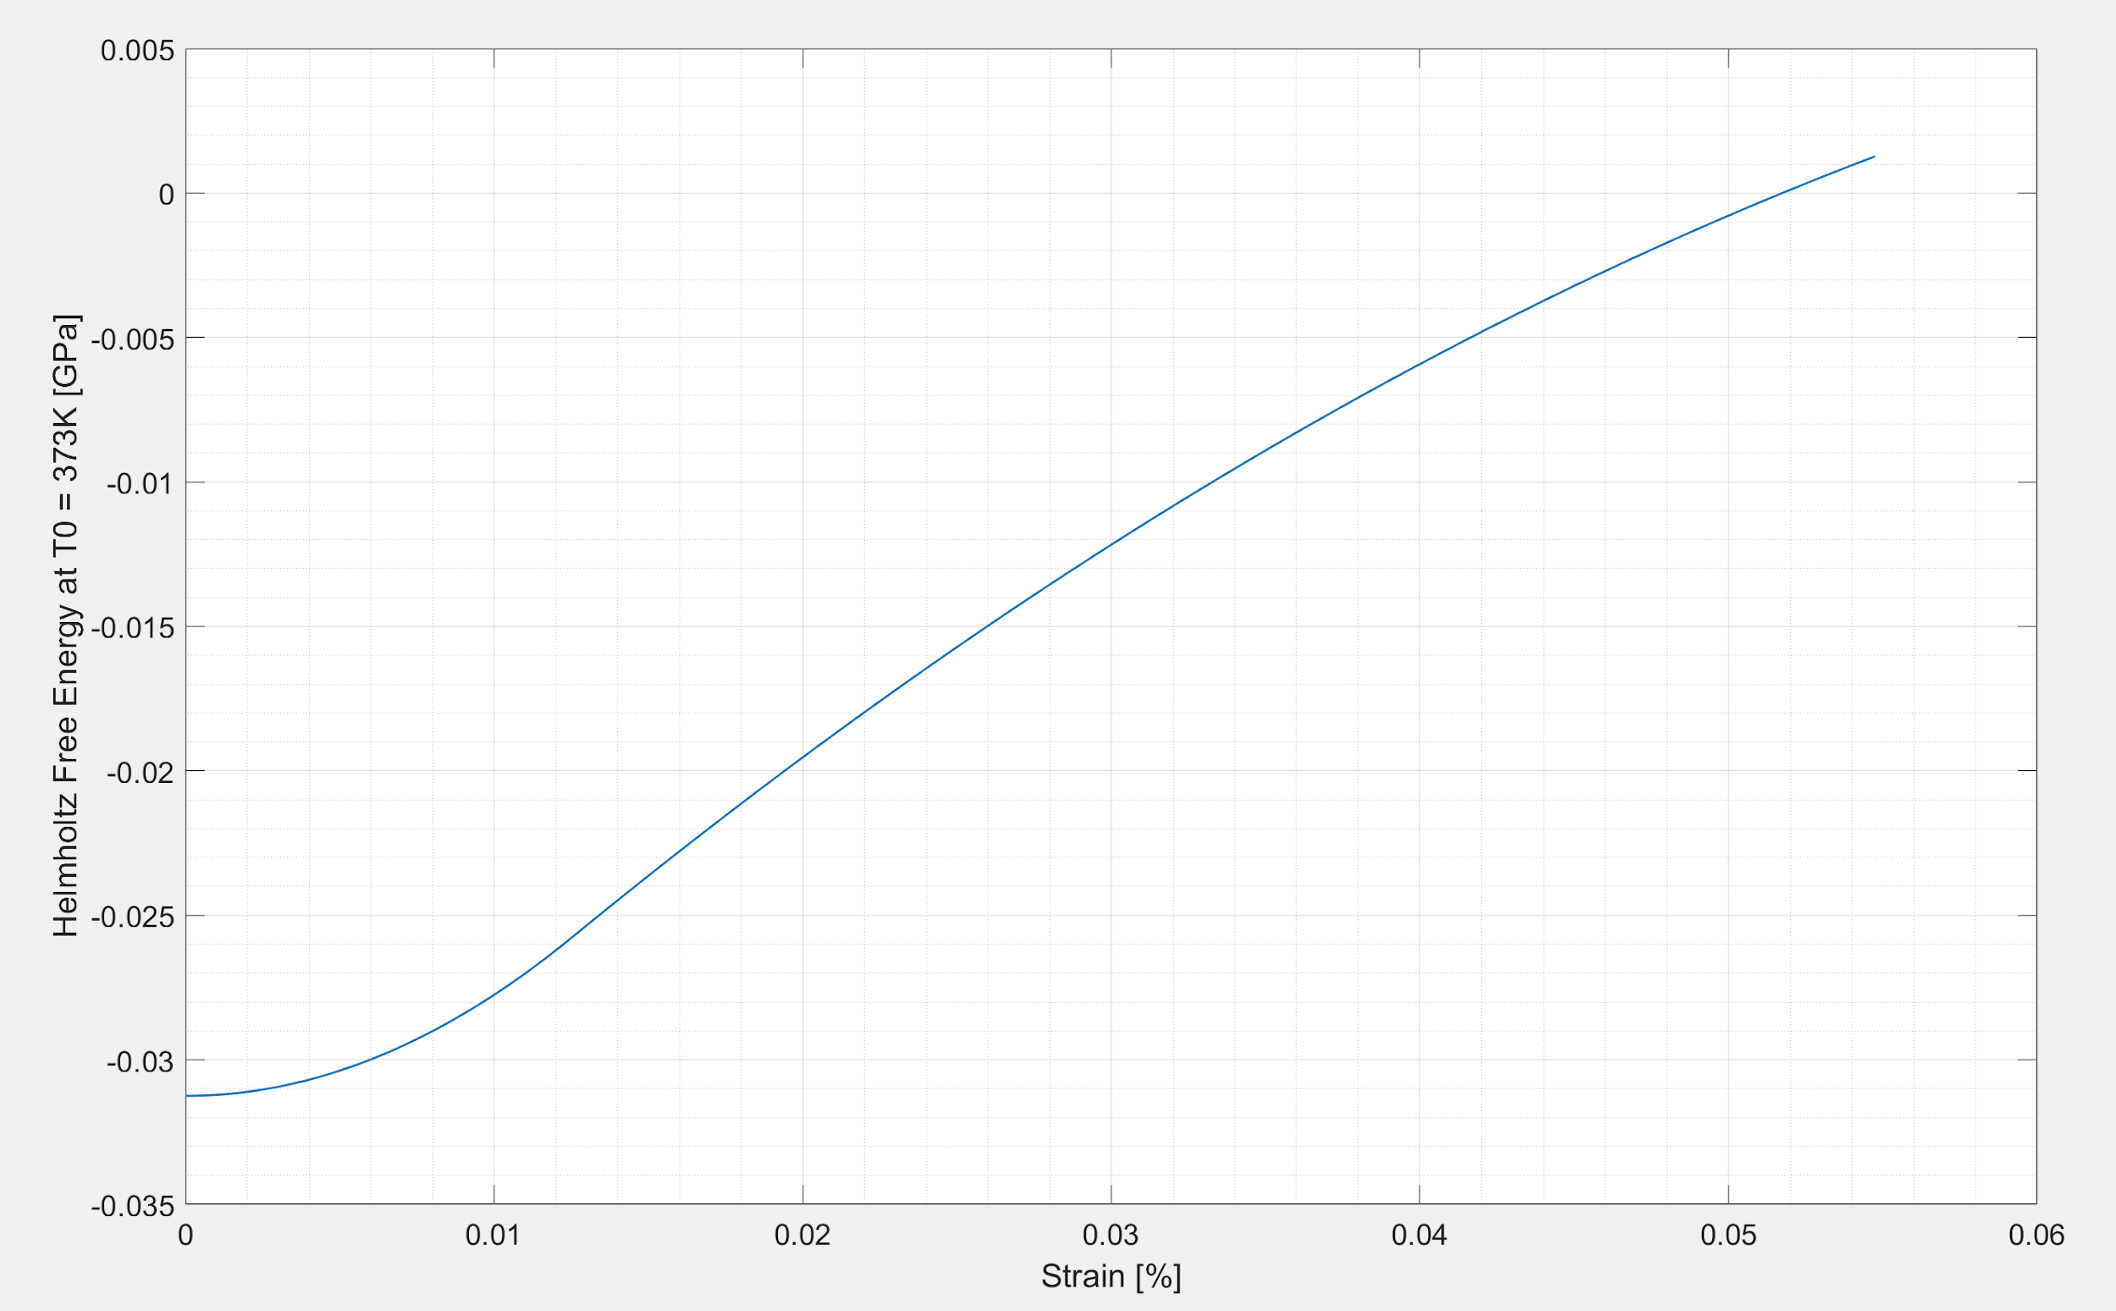
Exercise 3

Slide 5
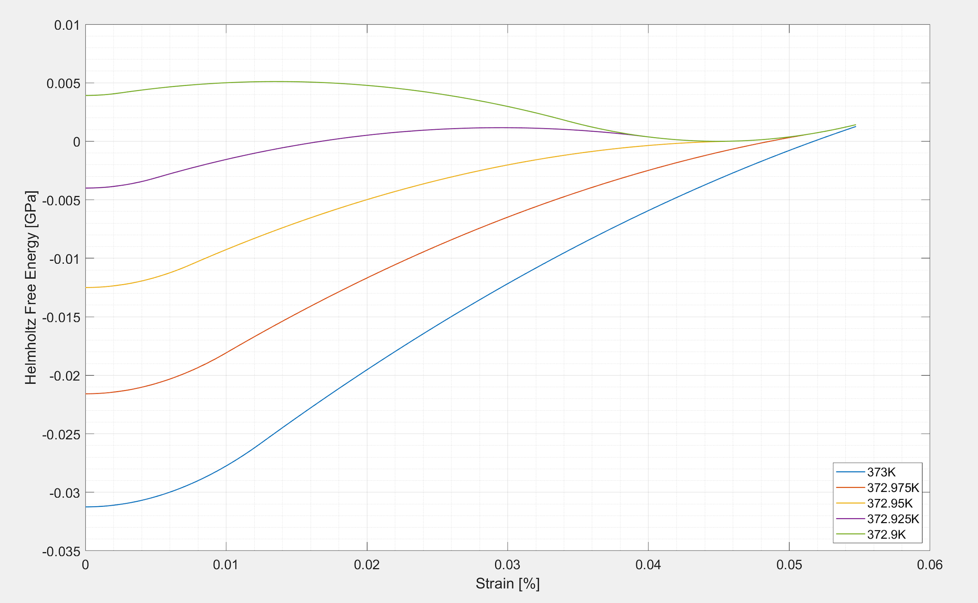
Exercise 4

Slide 6
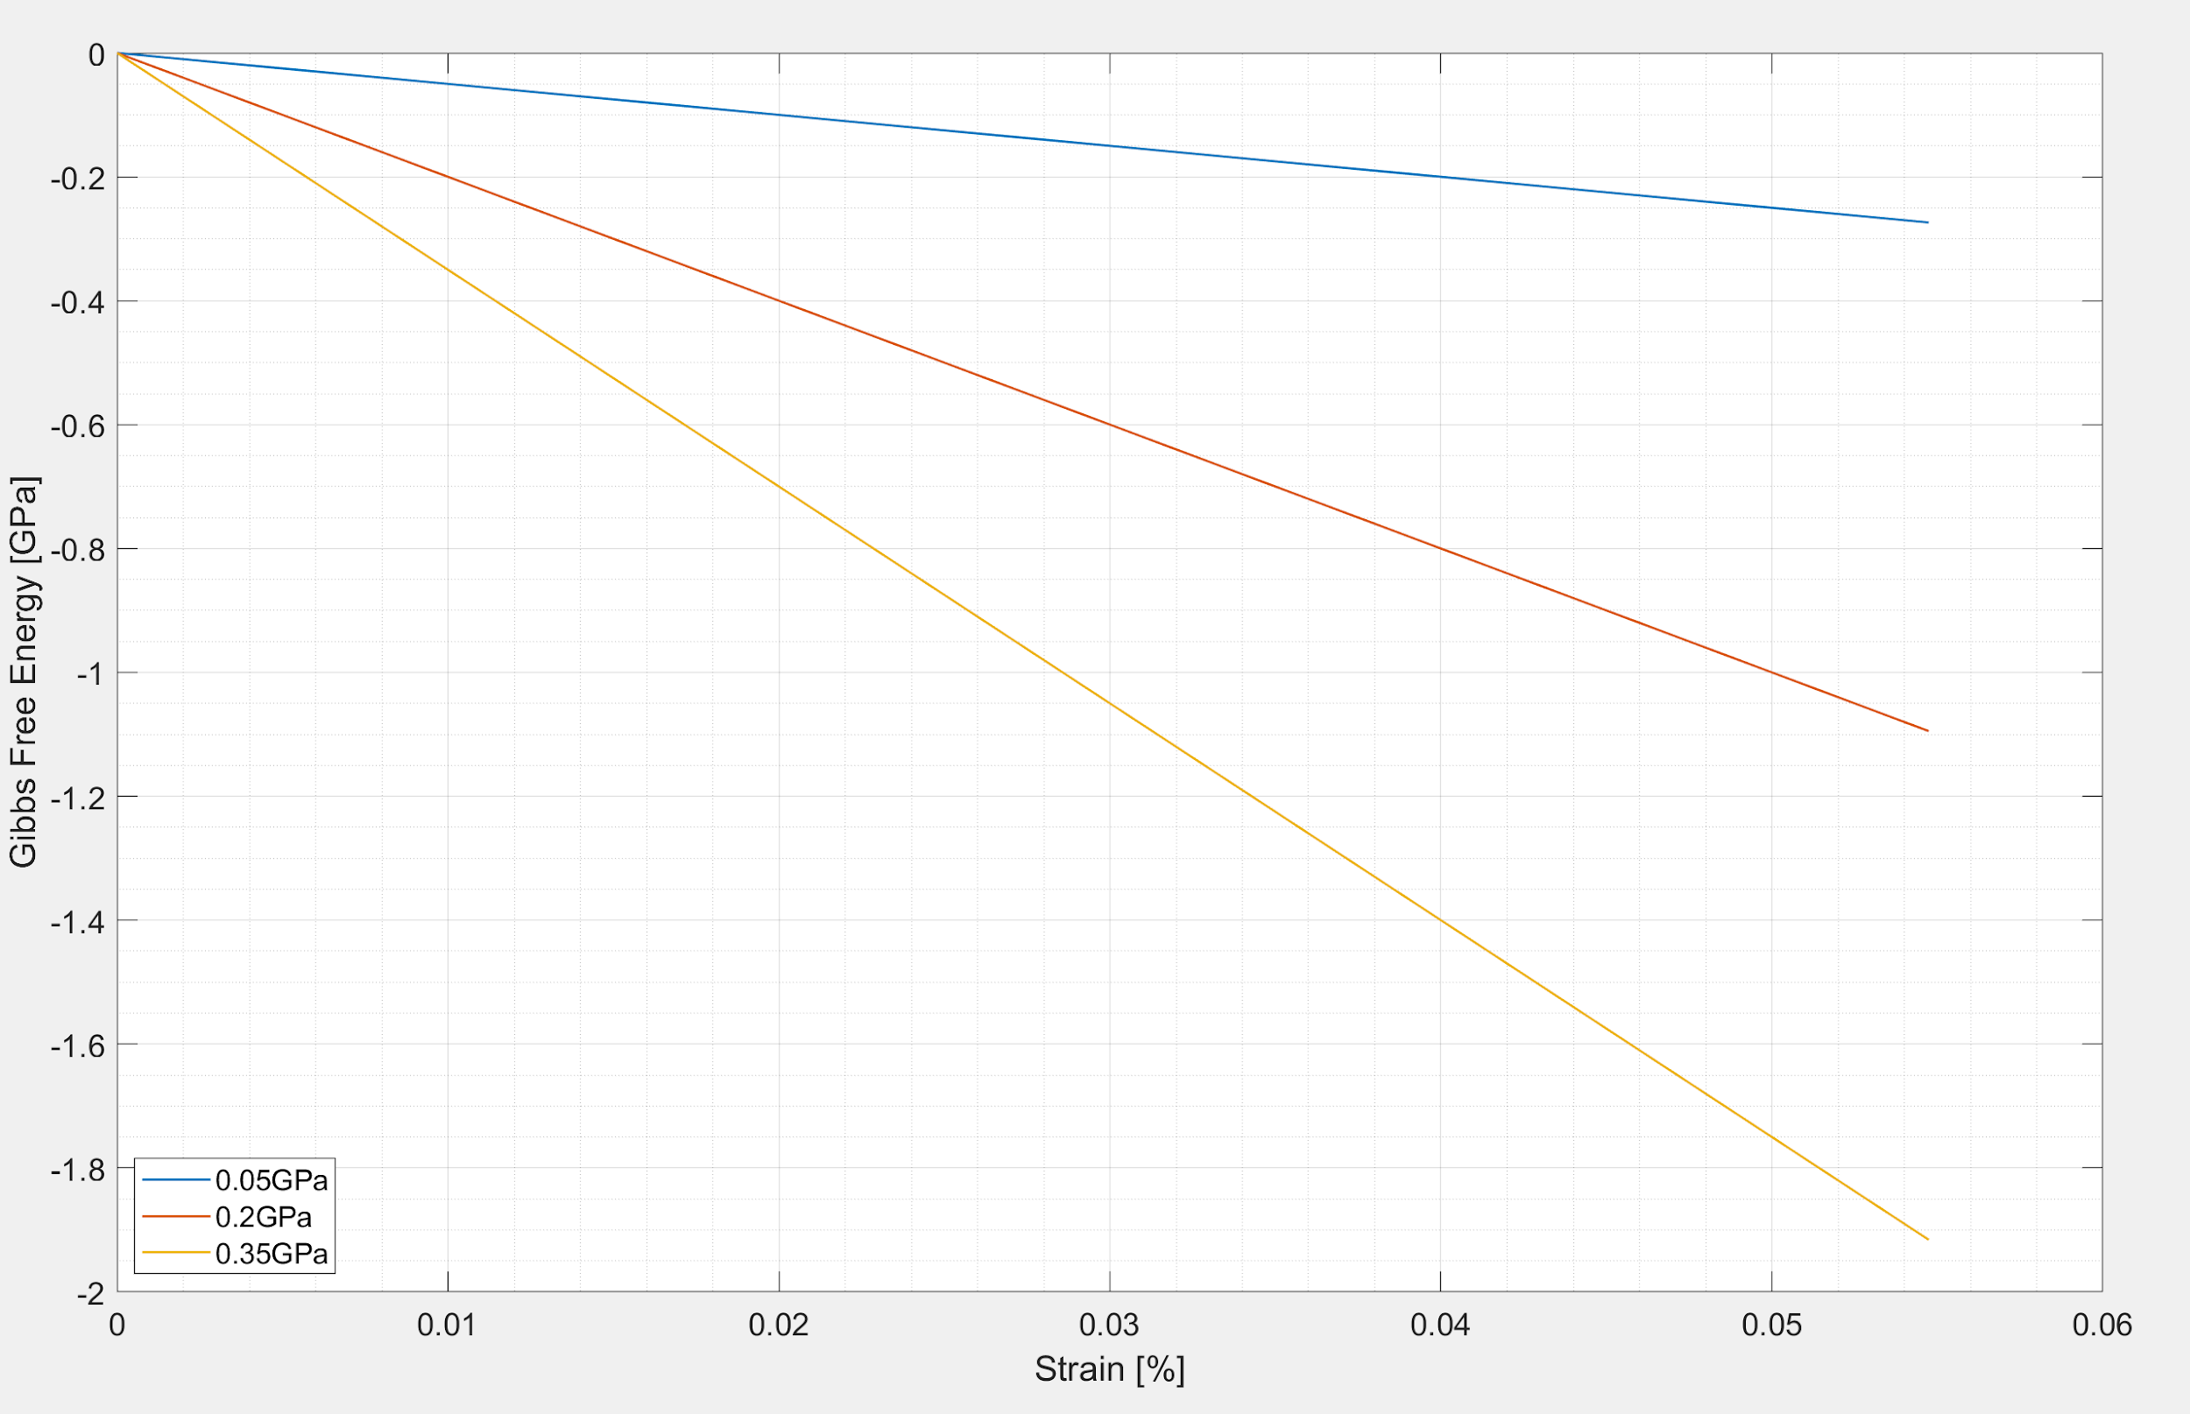
Exercise 5

